Slide 1
Routing with Authentication

Slide 2
Problems
Authentication
Public Private Route Handling
Static and Dynamic Header Footer Rendering
Roles handling
Default Routing
Handling of Data through Routing
Wrapping of Components

Slide 3
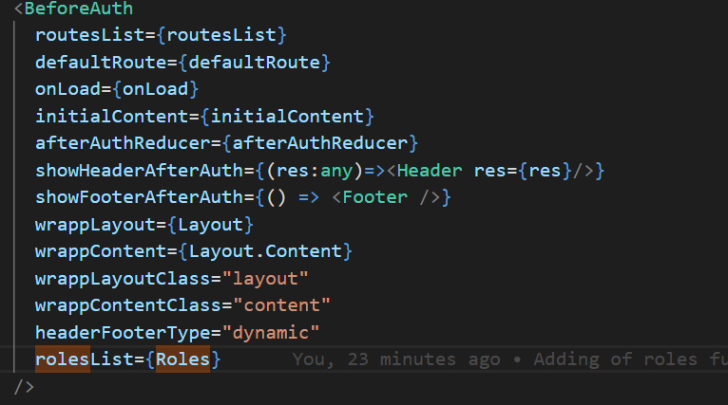
Component

Slide 4
Component
routesList
defaultRoute
onLoad
initialContent
afterAuthReducer
showHeaderAfterAuth
showFooterAfterAuth
wrappLayout
wrappContent
wrappLayoutClass
wrappContentClass
headerFooterType

Slide 5
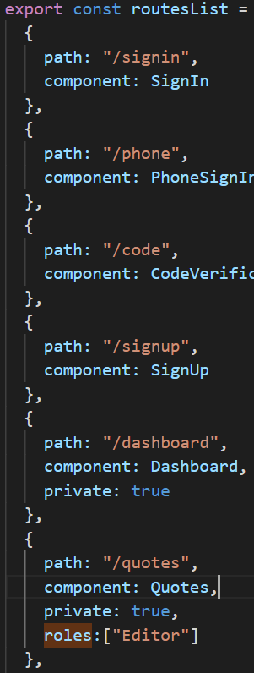
Routes List

Slide 6
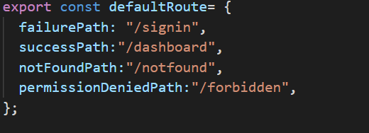
Default Routes

Slide 7
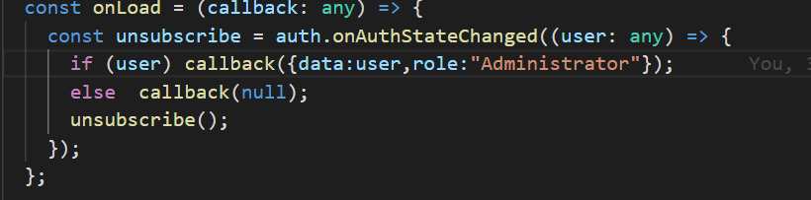
onLoad(function)

Slide 8
initialContent
Reducer initial content

Slide 9
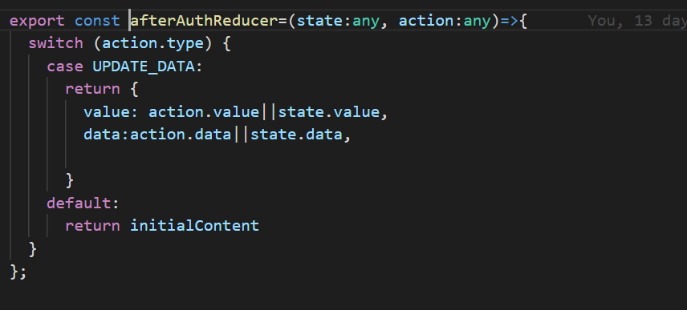
afterAuthReducer (Reducer function)

Slide 10
showHeaderAfterAuth/ showFooterAfterAuth

Slide 11
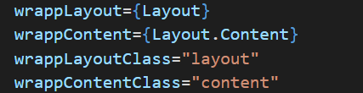
Wrapping of components
wrappLayout
wrappContent
wrappLayoutClass
wrappContentClass

Slide 12
Static/Dynamic Header Footer

Slide 13
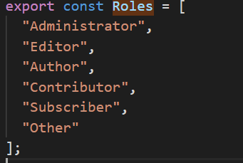
Roles List

Slide 14
Exposed Content
Content
Role (List)
Dispatch (Method)
isSignedIn( Boolean)
data
logout(Method)
signIn(Method)
Error(String)
dispatchAction(Method)

Slide 15
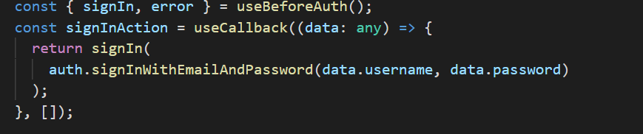
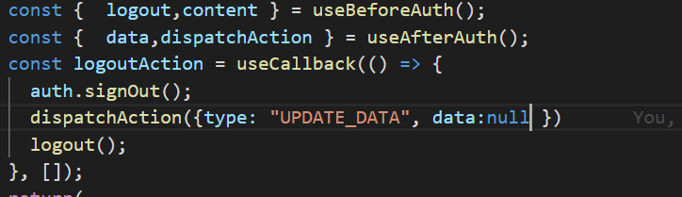
How to use?
SignIn
Logout

Slide 16

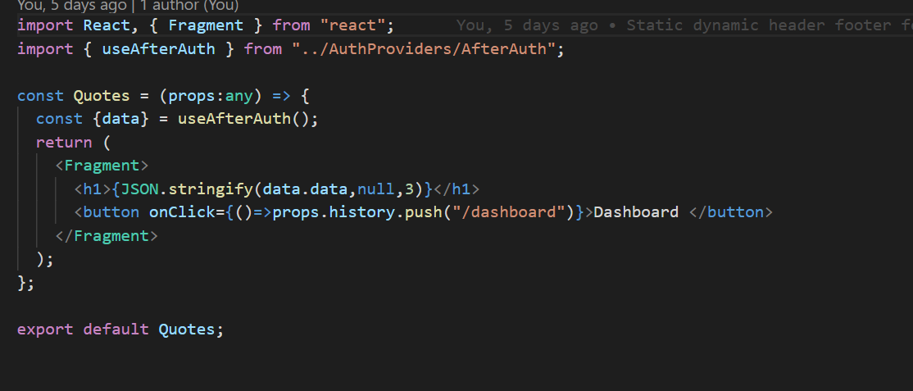
Usage After LoggedIn

Slide 17
Suggestions

